Slide 1
RSA Algorithm

Slide 2
Euler Totient Function ø(n)
to compute ø(n) need to count number of elements to be excluded
in general need prime factorization, but
  for p (p prime) ø(p) = p-1
  for p.q (p,q prime) ø(p.q) = (p-1)(q-1)
eg.
  ø(37) = 36

Slide 3
RSA
by Rivest, Shamir & Adleman of MIT in 1977
best known & widely used public-key scheme
based on exponentiation in a finite (Galois) field over integers modulo a prime
  nb. exponentiation takes O((log n)³) operations (easy)
uses large integers (eg. 1024 bits)
security due to cost of factoring large numbers
  nb. factorization takes O(e ^{log n log log n}) operations (hard)

Slide 4
RSA algorithm
Picks (randomly) two large prime numbers and calls them p and q.
Calculates their product and calls it n.
Calculates the totient of n ; it is simply ( p −1)(q −1).
Picks a random integer that is coprime to φ(n) and call this e.
A simple way is to just pick a random number>max( p,q)
Calculates (via the Euclidean algorithm) the multiplicative inverse of e modulo φ(n) and call this number d.

Slide 5
P=47 Q=71, N = P * Q = 3337
φ(n) = (p -1) (q-1) = 3220 Factors 2,2,5,7 and 23 (2*2*5*7 = 3220)
Choose e such that it is none of the factors of e is 2,5,7,23
  Eg. 4 cannot be chosen because 2 is the factor of 4
  15 cannot be chosen because 5 is a factor of 15
  E =79 ok, because it does not have the above factors
E is the encryption key (Public key)
Choose d (Decryption key) the private key such that
(d * e) mod (p-1) * (q-1) = 1, (d*79) mod (46) * (70) =1
(d * 79) mod (3220) =1 d= 1019
since (1019 * 79 ) mod (3220) = 80501 mod 3220 = 1
Encryption
M = 688 , CT = 688⁷⁹ mod 3337 = 1570
Send 1570 to receiver
Decryption
C=1570 , m = 1570¹⁰¹⁹ mod 3337 = 688

Slide 6
Example
Choose p = 3 and q = 11
Compute n = p * q = 3 * 11 = 33
Compute φ(n) = (p - 1) * (q - 1) = 2 * 10 = 20
Choose e such that 1 < e < φ(n) and e and n are coprime. Let e = 7
Compute a value for d such that (d * e) % φ(n) = 1. One solution is d = 3 [(3 * 7) % 20 = 1]
Public key is (e, n) => (7, 33)
Private key is (d, n) => (3, 33)
The encryption of m = 2 is c = 2⁷ % 33 = 29
The decryption of c = 29 is m = 29³ % 33 = 2

Slide 7
RSA algorithm
Select two large prime numbers p, q
Compute
n = p × q
φ(n) = (p-1) × (q-1)
Select small odd integer k relatively prime to v gcd(k, φ(n)) = 1
Compute d such that
(d × k)% φ(n) = (k × d)% φ(n) = 1
Public key is (k, n)
Private key is (d, n)
example
    p = 11
    q = 29
    n = 319
    φ(n) = 280
    k = 3
    d = 187
public key
    (3, 319)
private key
    (187, 319)

Slide 8
Encryption and decryption
Alice and Bob would like to communicate in private
Alice uses RSA algorithm to generate her public and private keys
  Alice makes key (k, n) publicly available to Bob and anyone else wanting to send her private messages
Bob uses Alice’s public key (k, n) to encrypt message M:
  compute E(M) =(M^{k})%n
  Bob sends encrypted message E(M) to Alice
Alice receives E(M) and uses private key (d, n) to decrypt it:
  compute D(M) = (E(M)^{d})%n
  decrypted message D(M) is original message M

Slide 9
Outline of implementation
RSA algorithm for key generation
  select two prime numbers p, q
  compute n = p × q
  v = (p-1) × (q-1)
  select small odd integer k such that
      gcd(k, v) = 1
  compute d such that
  (d × k)%v = 1
RSA algorithm for encryption/decryption
  encryption: compute E(M) = (M^{k})%n
  decryption: compute D(M) = (E(M)^{d})%n

Slide 10
RSA algorithm for key generation
Input: none
Computation:
  select two prime integers p, q
  compute integers n = p × q
  φ(n) = (p-1) × (q-1)
  select small odd integer k such that gcd(k, φ(n)) = 1
  compute integer d such that (d × k)% φ(n) = 1
Output: n, k, and d

Slide 11
RSA algorithm for encryption
Input: integers k, n, M
  M is integer representation of plaintext message
Computation:
  let C be integer representation of ciphertext
  C = (M^{k})%n
Output: integer C
  ciphertext or encrypted message

Slide 12
RSA algorithm for decryption
Input: integers d, n, C
  C is integer representation of ciphertext message
Computation:
  let D be integer representation of decrypted ciphertext
  D = (C^{d})%n
Output: integer D
  decrypted message

Slide 13
RSA Security
three approaches to attacking RSA:
  brute force key search (infeasible given size of numbers)
  mathematical attacks (based on difficulty of computing ø(N), by factoring modulus N)
  timing attacks (on running of decryption)

Slide 14
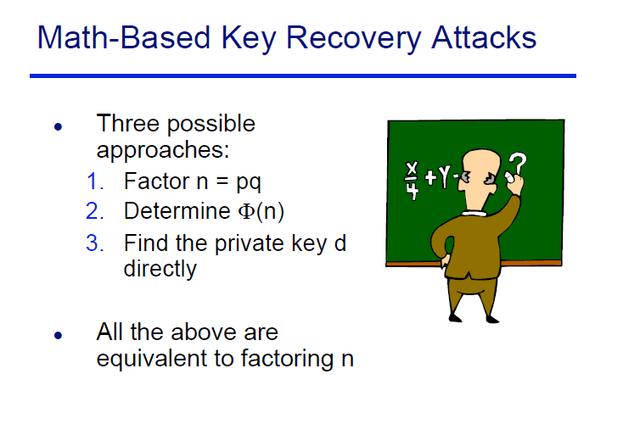

Slide 15
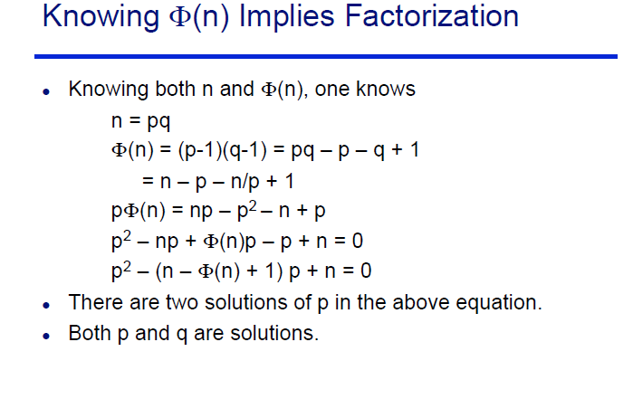

Slide 16
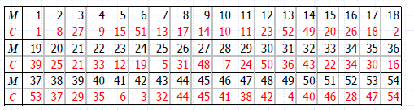
Solve
p = 7, q = 17, e = 5 ,M = 19 find d and c
p = 5, q = 11, e = 3, Find d
In a public-key system using RSA, you intercept the Ciphertext C = 10 sent to a user whose public key is e = 5, n = 35. What is the plaintext M?

